Slide 1


Network Size Reduction Using Clustering Method for Bridge Transportation Network
Denissa Sari Darmawi Purba
MS Civil Engineering – Societal Risk Management, Civil and Environmental Department
University of Illinois Urbana Champaign

Slide 2
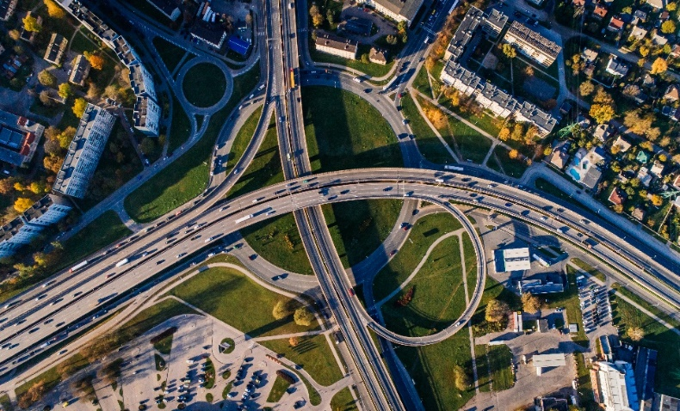
IE 532 – ANALYSIS OF NETWORK DATA
Study of Bridge Asset Management
Is extensively studied in civil engineering field
Resilient and Sustainable Infrastructure
“the ability of such infrastructure systems (including their interconnected ecosystems and social systems) to absorb disturbance and still retain their basic function and structural capacity”
Bridge/Transportation holds major role
Economic growth
Social development
Support daily need of communities
Connect the communities during emergencies
Indicator of success of country
This risk management includes every phase of infrastructure design:
Mitigation Planning
Emergency Response Design
Recovery Planning
Operation and Maintenance
Design and Construction Phase
UNIVERSITY OF ILLINOIS-URBANA CHAMPAIGN

Slide 3

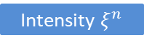
IE 532 – ANALYSIS OF NETWORK DATA
Two Main Challenges in Bridge’s Risk Mitigation Planning
Large-scale Network and Large-size Hazard Scenario/Simulation
Network-based approach is necessary to describe the interdependency and sharing capacity of each infrastructure while serving its function.
Scenario-based approach is commonly used in risk assessment to evaluate the effect of hazard’s uncertainty to the network performance.
Intensity $ξ^{1}$
. . .
Intensity $ξ^{n}$
bridge
bridge
bridge partially damaged
X
s
t
s
Bridge
failed
t
bridge
bridge survived
The size of network increase according to the increase of the number of scenarios and the number of simulation’s types.
UNIVERSITY OF ILLINOIS-URBANA CHAMPAIGN

Slide 4
IE 532 – ANALYSIS OF NETWORK DATA
Two Main Challenges in Bridge’s Risk Mitigation Planning
Bridge Criticality Loss due to Network Redundancy
Network redundancy (Mesh) is a process through which additional or alternate instances of network are installed within network infrastructure for ensuring network connectivity in case of path failure and unavailability.
Commonly found and implemented in telecommunication network and internet network.
Other Asset
Bridge
Other Asset
Q: Does Bridge Transportation Network Hold this Characteristic?
YES!
UNIVERSITY OF ILLINOIS-URBANA CHAMPAIGN
Notes:
picture

Slide 5
IE 532 – ANALYSIS OF NETWORK DATA
Two Main Challenges in Bridge’s Risk Mitigation Planning
Bridge Criticality Loss due to Network Redundancy
Even though bridges are believed to be the most critical infrastructure in transportation network, the number of bridge in transportation network is not as significant as number of roads.
Through this number, it is possible that there is exist network redundancy in transportation network depends on its topology.
If there is existed alternative asset that provides well connectivity and network’s performance, then bridge will lose its importance rank in the network.
MEMPHIS,TN
603 / 64,398
Bridges Total Edges
CHICAGO,IL
787 / 75,947
Bridges Total Edges
It is important to:
Evaluate the criticality of bridges in a given transportation network
Reduce the number of links in network to be closed to the number of bridges.
UNIVERSITY OF ILLINOIS-URBANA CHAMPAIGN

Slide 6
IE 532 – ANALYSIS OF NETWORK DATA
Objective: Study clustering framework to reduce the complexity of network and provide information of the criticality of bridges
STEP 1: Define Link Weight
STEP 2: Clustering Girvan-Newman
STEP 3: Adjust Bridge Dominance
STEP 4: Big Node and Super Link
UNIVERSITY OF ILLINOIS-URBANA CHAMPAIGN

Slide 7
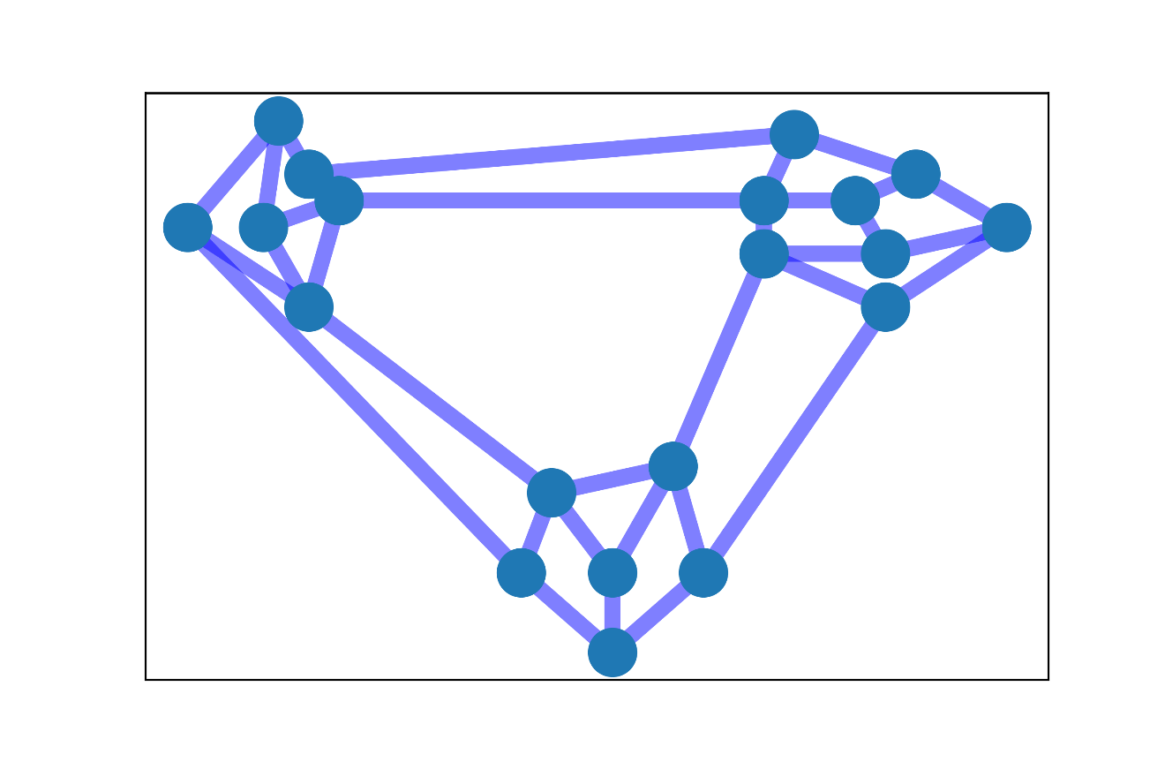
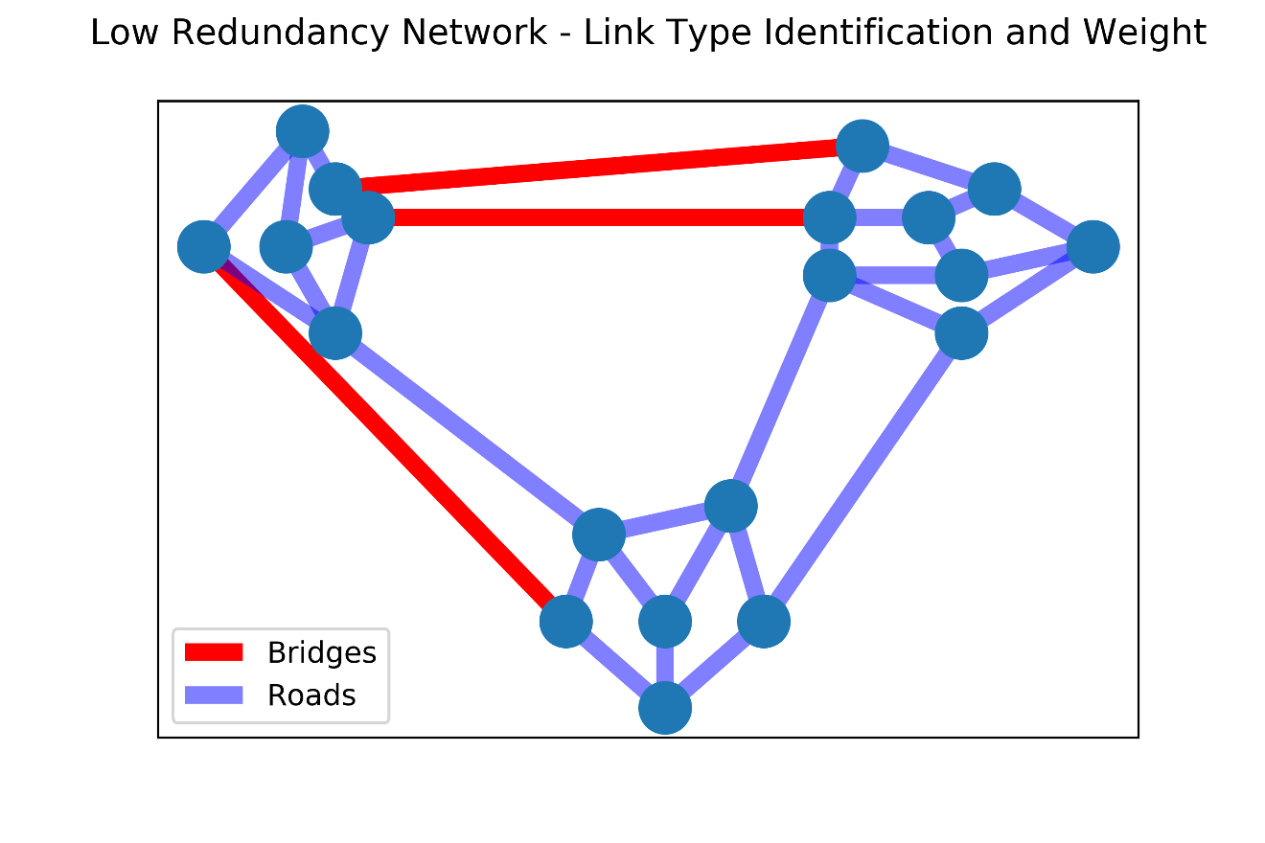
IE 532 – ANALYSIS OF NETWORK DATA
CASE 1: Low Network Redundancy
Q: Where do we find these type of Bridge Transportation?
Intercity Transportation Network
Transportation Network in River Area
California
New York
Oregon
UNIVERSITY OF ILLINOIS-URBANA CHAMPAIGN

Slide 8
IE 532 – ANALYSIS OF NETWORK DATA
CASE 1: Low Network Redundancy
Q: Where do we find these type of Bridge Transportation?
Intercity Transportation Network
Transportation Network in River Area
California
New York
Oregon
UNIVERSITY OF ILLINOIS-URBANA CHAMPAIGN

Slide 9
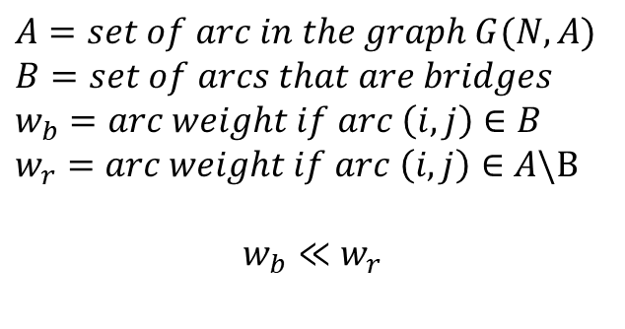
IE 532 – ANALYSIS OF NETWORK DATA
CASE 1: Low Network Redundancy
STEP 1: Define Link Weight
$$A=set of arc in the graph G(N,A)$$
$$B=set of arcs that are bridges$$
$$w_{b}=arc weight if arc \left(i,j\right)∈B$$
$$w_{r}=arc weight if arc \left(i,j\right)∈A\backslash B$$
$$w_{b}≪w_{r}$$
This weight represent the loss or drawback of arcs. We assume that bridge have lower drawback (higher benefit) in functionality of the network than the road.
This weight could represent time delay, time travel, etc.
UNIVERSITY OF ILLINOIS-URBANA CHAMPAIGN

Slide 10
IE 532 – ANALYSIS OF NETWORK DATA
CASE 1: Low Network Redundancy
STEP 1: Define Link Weight
10
1
10
10
1
10
10
10
10
$$A=set of arc in the graph G(N,A)$$
$$B=set of arcs that are bridges$$
$$w_{b}=arc weight if arc \left(i,j\right)∈B$$
$$w_{r}=arc weight if arc \left(i,j\right)∈A\backslash B$$
$$w_{b}≪w_{r}$$
10
10
10
10
10
10
10
10
10
10
1
10
10
10
10
10
10
This weight represent the loss or drawback of arcs. We assume that bridge have lower drawback (higher benefit) in functionality of the network than the road.
This weight could represent time delay, time travel, etc.
10
10
UNIVERSITY OF ILLINOIS-URBANA CHAMPAIGN

Slide 11
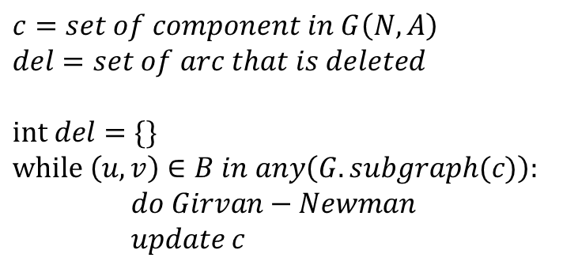
IE 532 – ANALYSIS OF NETWORK DATA
CASE 1: Low Network Redundancy
STEP 2: Clustering Girvan-Newman
10
1
10
10
1
10
10
10
10
$$c=set of component in G\left(N,A\right)$$
$$del=set of arc that is deleted$$
$$int del=\{\}$$
$$while \left(u,v\right)∈B in any\left(G.subgraph(c)\right):$$
$do Girvan−Newman$
$$update c$$
10
10
10
10
10
10
10
10
10
10
1
10
10
10
10
10
10
10
10
UNIVERSITY OF ILLINOIS-URBANA CHAMPAIGN

Slide 12
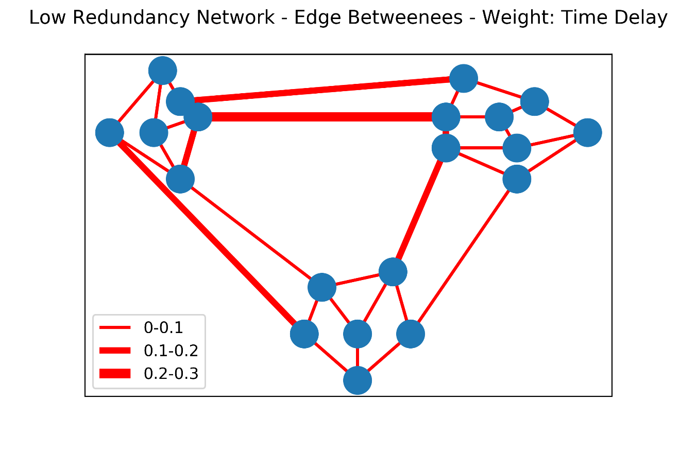
IE 532 – ANALYSIS OF NETWORK DATA
CASE 1: Low Network Redundancy
STEP 2: Clustering Girvan-Newman
$$c=set of component in G\left(N,A\right)$$
$$del=set of arc that is deleted$$
$$int del=\{\}$$
$$while \left(u,v\right)∈B in any\left(G.subgraph(c)\right):$$
$do Girvan−Newman$
$$update c$$
UNIVERSITY OF ILLINOIS-URBANA CHAMPAIGN

Slide 13
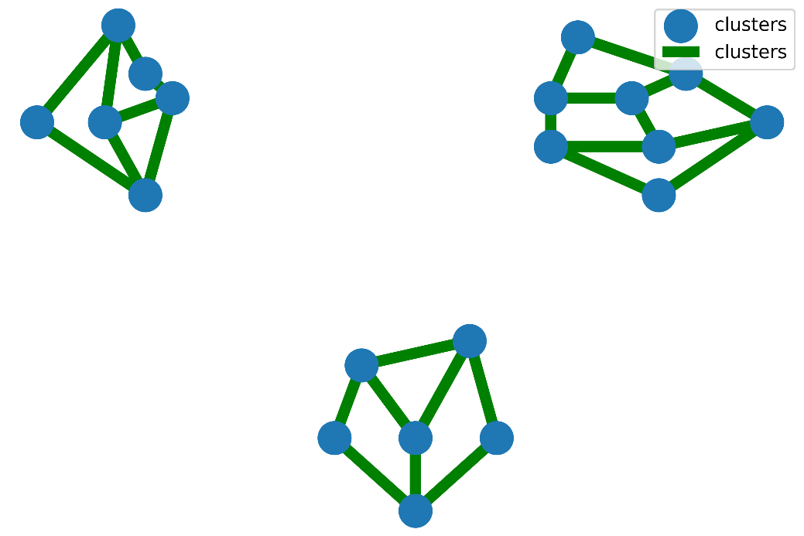
IE 532 – ANALYSIS OF NETWORK DATA
CASE 1: Low Network Redundancy
STEP 2: Clustering Girvan-Newman
$$c=set of component in G\left(N,A\right)$$
$$del=set of arc that is deleted$$
$$int del=\{\}$$
$$while \left(u,v\right)∈B in any\left(G.subgraph(c)\right):$$
$do Girvan−Newman$
$$update c$$
C1
C2
C3
UNIVERSITY OF ILLINOIS-URBANA CHAMPAIGN

Slide 14
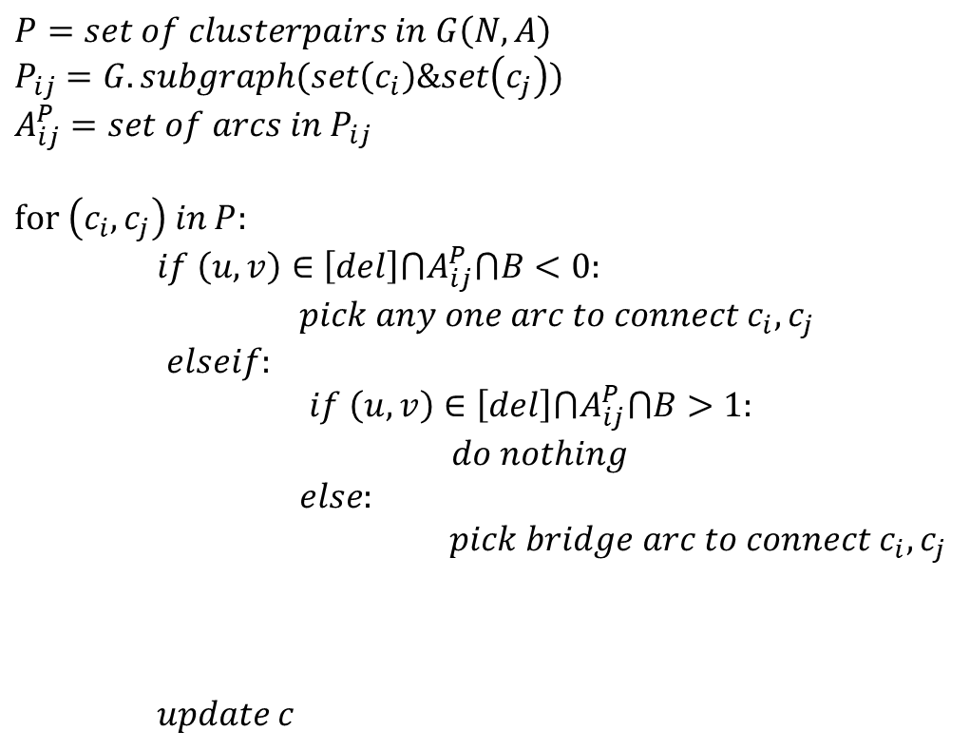
IE 532 – ANALYSIS OF NETWORK DATA
CASE 1: Low Network Redundancy
STEP 3: Adjust Bridge Dominance
$$P=set of clusterpairs in G\left(N,A\right)$$
$$P_{ij}=G.subgraph(set\left(c_{i}\right)\&set\left(c_{j}\right))$$
$$A_{ij}^{P}=set of arcs in P_{ij}$$
$$for \left(c_{i},c_{j}\right) in P:$$
$if \left(u,v\right)∈\left[del\right]⋂A_{ij}^{P}⋂B<0:$
$pick any one arc to connect c_{i},c_{j}$
$elseif:$
$if \left(u,v\right)∈\left[del\right]⋂A_{ij}^{P}⋂B>1:$
$do nothing$
$else:$
$pick bridge arc to connect c_{i}, c_{j}$
$$update c$$
C1
C2
C3
UNIVERSITY OF ILLINOIS-URBANA CHAMPAIGN

Slide 15
IE 532 – ANALYSIS OF NETWORK DATA
CASE 1: Low Network Redundancy
STEP 3: Adjust Bridge Dominance
$$P=set of clusterpairs in G\left(N,A\right)$$
$$P_{ij}=G.subgraph(set\left(c_{i}\right)\&set\left(c_{j}\right))$$
$$A_{ij}^{P}=set of arcs in P_{ij}$$
$$for \left(c_{i},c_{j}\right) in P:$$
$if \left(u,v\right)∈\left[del\right]⋂A_{ij}^{P}⋂B<0:$
$pick any one arc to connect c_{i},c_{j}$
$elseif:$
$if \left(u,v\right)∈\left[del\right]⋂A_{ij}^{P}⋂B>1:$
$do nothing$
$else:$
$pick bridge arc to connect c_{i}, c_{j}$
$$update c$$
C1
C2
C3
UNIVERSITY OF ILLINOIS-URBANA CHAMPAIGN

Slide 16
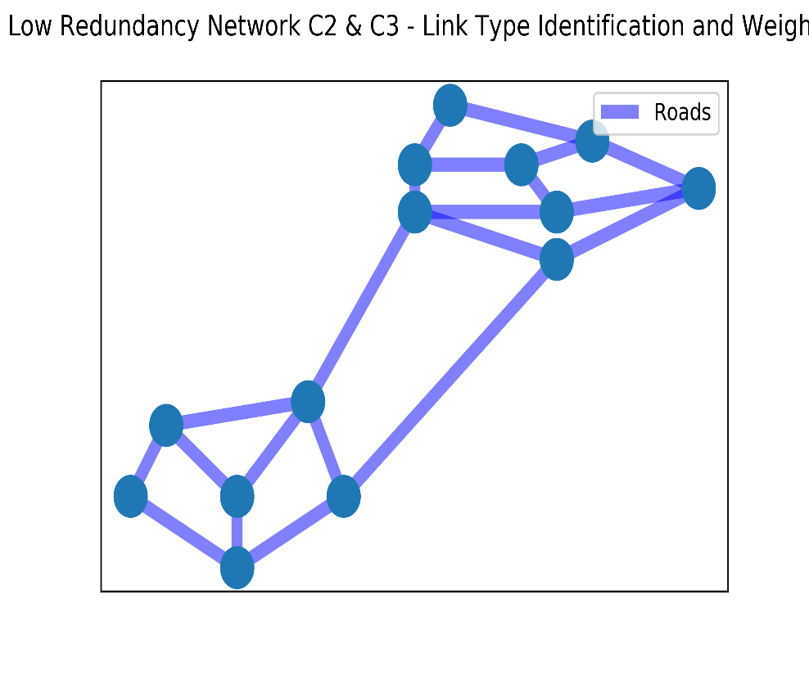
IE 532 – ANALYSIS OF NETWORK DATA
CASE 1: Low Network Redundancy
STEP 3: Adjust Bridge Dominance
$$P=set of clusterpairs in G\left(N,A\right)$$
$$P_{ij}=G.subgraph(set\left(c_{i}\right)\&set\left(c_{j}\right))$$
$$A_{ij}^{P}=set of arcs in P_{ij}$$
$$for \left(c_{i},c_{j}\right) in P:$$
$if \left(u,v\right)∈\left[del\right]⋂A_{ij}^{P}⋂B<0:$
$pick any one arc to connect c_{i},c_{j}$
$elseif:$
$if \left(u,v\right)∈\left[del\right]⋂A_{ij}^{P}⋂B>1:$
$do nothing$
$else:$
$pick bridge arc to connect c_{i}, c_{j}$
$$update c$$
UNIVERSITY OF ILLINOIS-URBANA CHAMPAIGN

Slide 17
IE 532 – ANALYSIS OF NETWORK DATA
CASE 1: Low Network Redundancy
STEP 3: Adjust Bridge Dominance
$$P=set of clusterpairs in G\left(N,A\right)$$
$$P_{ij}=G.subgraph(set\left(c_{i}\right)\&set\left(c_{j}\right))$$
$$A_{ij}^{P}=set of arcs in P_{ij}$$
$$for \left(c_{i},c_{j}\right) in P:$$
$if \left(u,v\right)∈\left[del\right]⋂A_{ij}^{P}⋂B<0:$
$pick any one arc to connect c_{i},c_{j}$
$elseif:$
$if \left(u,v\right)∈\left[del\right]⋂A_{ij}^{P}⋂B>1:$
$do nothing$
$else:$
$pick bridge arc to connect c_{i}, c_{j}$
$$update c$$
X
UNIVERSITY OF ILLINOIS-URBANA CHAMPAIGN

Slide 18
IE 532 – ANALYSIS OF NETWORK DATA
CASE 1: Low Network Redundancy
STEP 3: Adjust Bridge Dominance
$$P=set of clusterpairs in G\left(N,A\right)$$
$$P_{ij}=G.subgraph(set\left(c_{i}\right)\&set\left(c_{j}\right))$$
$$A_{ij}^{P}=set of arcs in P_{ij}$$
$$for \left(c_{i},c_{j}\right) in P:$$
$if \left(u,v\right)∈\left[del\right]⋂A_{ij}^{P}⋂B<0:$
$pick any one arc to connect c_{i},c_{j}$
$elseif:$
$if \left(u,v\right)∈\left[del\right]⋂A_{ij}^{P}⋂B>1:$
$do nothing$
$else:$
$pick bridge arc to connect c_{i}, c_{j}$
$$update c$$
C1
C2
C3
UNIVERSITY OF ILLINOIS-URBANA CHAMPAIGN

Slide 19
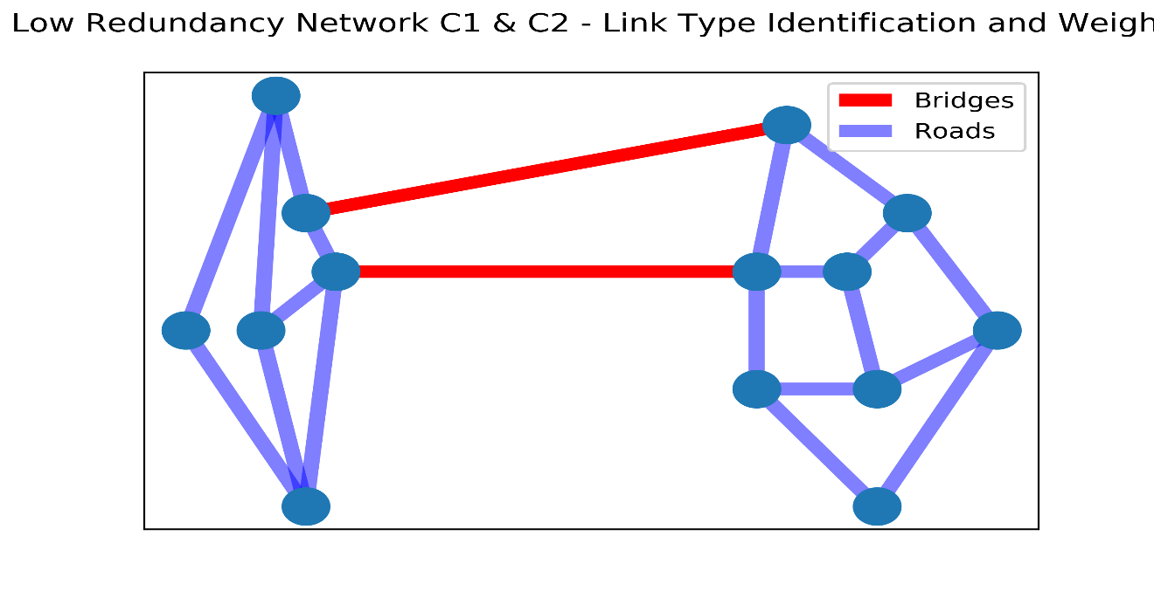
IE 532 – ANALYSIS OF NETWORK DATA
CASE 1: Low Network Redundancy
STEP 3: Adjust Bridge Dominance
$$P=set of clusterpairs in G\left(N,A\right)$$
$$P_{ij}=G.subgraph(set\left(c_{i}\right)\&set\left(c_{j}\right))$$
$$A_{ij}^{P}=set of arcs in P_{ij}$$
$$for \left(c_{i},c_{j}\right) in P:$$
$if \left(u,v\right)∈\left[del\right]⋂A_{ij}^{P}⋂B<0:$
$pick any one arc to connect c_{i},c_{j}$
$elseif:$
$if \left(u,v\right)∈\left[del\right]⋂A_{ij}^{P}⋂B>1:$
$do nothing$
$else:$
$pick bridge arc to connect c_{i}, c_{j}$
$$update c$$
UNIVERSITY OF ILLINOIS-URBANA CHAMPAIGN

Slide 20
IE 532 – ANALYSIS OF NETWORK DATA
CASE 1: Low Network Redundancy
STEP 3: Adjust Bridge Dominance
$$P=set of clusterpairs in G\left(N,A\right)$$
$$P_{ij}=G.subgraph(set\left(c_{i}\right)\&set\left(c_{j}\right))$$
$$A_{ij}^{P}=set of arcs in P_{ij}$$
$$for \left(c_{i},c_{j}\right) in P:$$
$if \left(u,v\right)∈\left[del\right]⋂A_{ij}^{P}⋂B<0:$
$pick any one arc to connect c_{i},c_{j}$
$elseif:$
$if \left(u,v\right)∈\left[del\right]⋂A_{ij}^{P}⋂B>1:$
$do nothing$
$else:$
$pick bridge arc to connect c_{i}, c_{j}$
$$update c$$
UNIVERSITY OF ILLINOIS-URBANA CHAMPAIGN

Slide 21
IE 532 – ANALYSIS OF NETWORK DATA
CASE 1: Low Network Redundancy
STEP 3: Adjust Bridge Dominance
$$P=set of clusterpairs in G\left(N,A\right)$$
$$P_{ij}=G.subgraph(set\left(c_{i}\right)\&set\left(c_{j}\right))$$
$$A_{ij}^{P}=set of arcs in P_{ij}$$
$$for \left(c_{i},c_{j}\right) in P:$$
$if \left(u,v\right)∈\left[del\right]⋂A_{ij}^{P}⋂B<0:$
$pick any one arc to connect c_{i},c_{j}$
$elseif:$
$if \left(u,v\right)∈\left[del\right]⋂A_{ij}^{P}⋂B>1:$
$do nothing$
$else:$
$pick bridge arc to connect c_{i}, c_{j}$
$$update c$$
C1
C2
C3
UNIVERSITY OF ILLINOIS-URBANA CHAMPAIGN

Slide 22
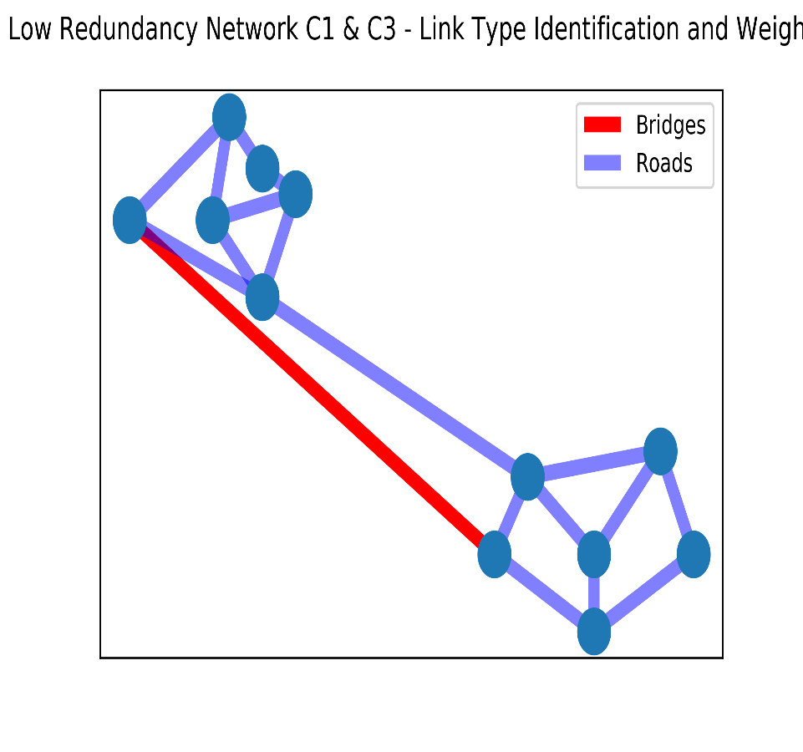
IE 532 – ANALYSIS OF NETWORK DATA
CASE 1: Low Network Redundancy
STEP 3: Adjust Bridge Dominance
$$P=set of clusterpairs in G\left(N,A\right)$$
$$P_{ij}=G.subgraph(set\left(c_{i}\right)\&set\left(c_{j}\right))$$
$$A_{ij}^{P}=set of arcs in P_{ij}$$
$$for \left(c_{i},c_{j}\right) in P:$$
$if \left(u,v\right)∈\left[del\right]⋂A_{ij}^{P}⋂B<0:$
$pick any one arc to connect c_{i},c_{j}$
$elseif:$
$if \left(u,v\right)∈\left[del\right]⋂A_{ij}^{P}⋂B>1:$
$do nothing$
$else:$
$pick bridge arc to connect c_{i}, c_{j}$
$$update c$$
UNIVERSITY OF ILLINOIS-URBANA CHAMPAIGN

Slide 23
IE 532 – ANALYSIS OF NETWORK DATA
CASE 1: Low Network Redundancy
STEP 3: Adjust Bridge Dominance
$$P=set of clusterpairs in G\left(N,A\right)$$
$$P_{ij}=G.subgraph(set\left(c_{i}\right)\&set\left(c_{j}\right))$$
$$A_{ij}^{P}=set of arcs in P_{ij}$$
$$for \left(c_{i},c_{j}\right) in P:$$
$if \left(u,v\right)∈\left[del\right]⋂A_{ij}^{P}⋂B<0:$
$pick any one arc to connect c_{i},c_{j}$
$elseif:$
$if \left(u,v\right)∈\left[del\right]⋂A_{ij}^{P}⋂B>1:$
$do nothing$
$else:$
$pick bridge arc to connect c_{i}, c_{j}$
$$update c$$
UNIVERSITY OF ILLINOIS-URBANA CHAMPAIGN

Slide 24
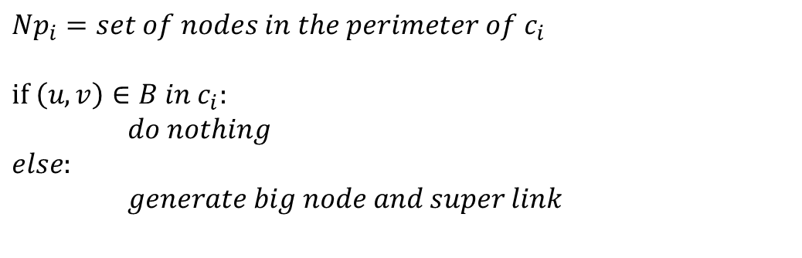
IE 532 – ANALYSIS OF NETWORK DATA
CASE 1: Low Network Redundancy
STEP 4: Big Node and Super Link
Ci
$$Np_{i}=set of nodes in the perimeter of c_{i}$$
$$if \left(u,v\right)∈B in c_{i}:$$
$do nothing$
$$else:$$
$generate big node and super link$
Perimeter Node
UNIVERSITY OF ILLINOIS-URBANA CHAMPAIGN

Slide 25
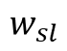
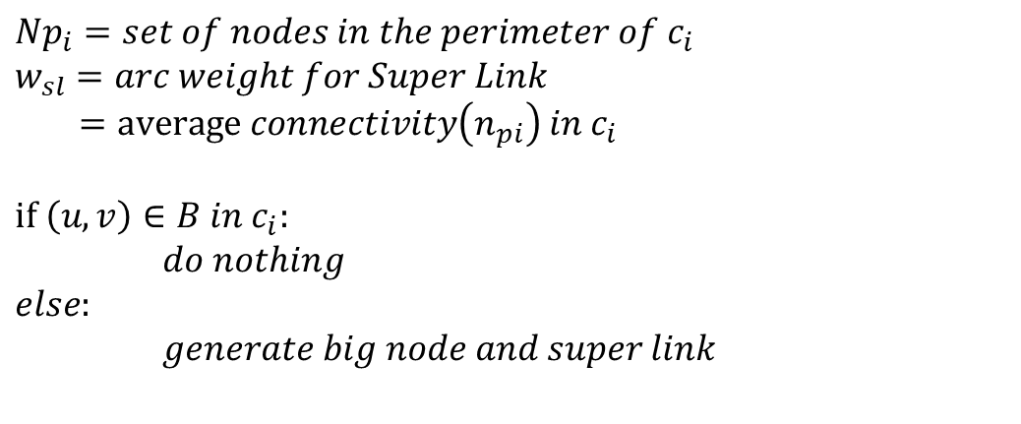
IE 532 – ANALYSIS OF NETWORK DATA
CASE 1: Low Network Redundancy
STEP 4: Big Node and Super Link
Ci
$$Np_{i}=set of nodes in the perimeter of c_{i}$$
$$w_{sl}=arc weight for Super Link$$
$=average connectivity\left(n_{pi}\right) in c_{i}$
$$if \left(u,v\right)∈B in c_{i}:$$
$do nothing$
$$else:$$
$generate big node and super link$
Super Link
$$w_{sl}$$
Perimeter Node
Big Node
UNIVERSITY OF ILLINOIS-URBANA CHAMPAIGN

Slide 26
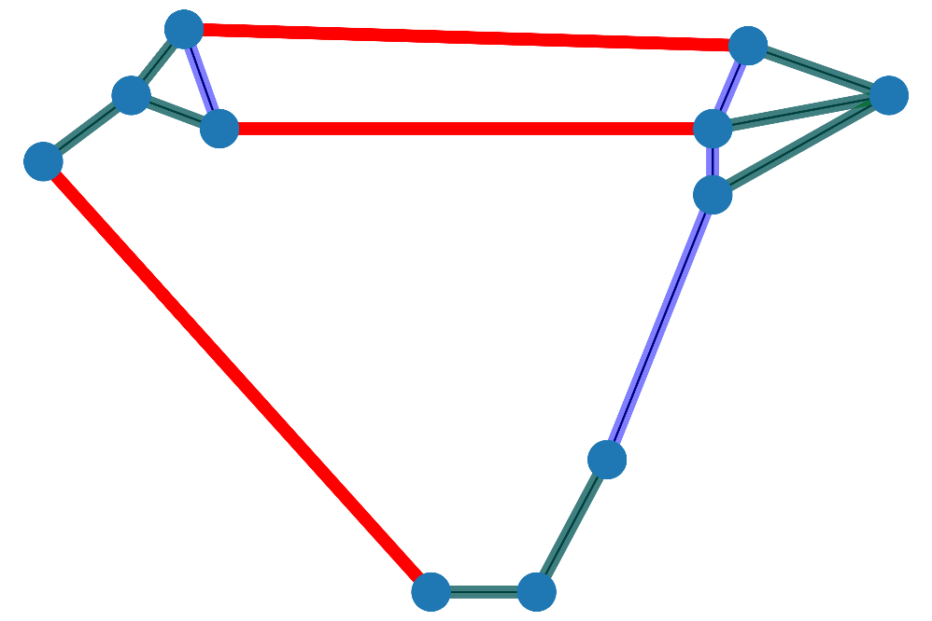
IE 532 – ANALYSIS OF NETWORK DATA
CASE 1: Low Network Redundancy
UNIVERSITY OF ILLINOIS-URBANA CHAMPAIGN

Slide 27
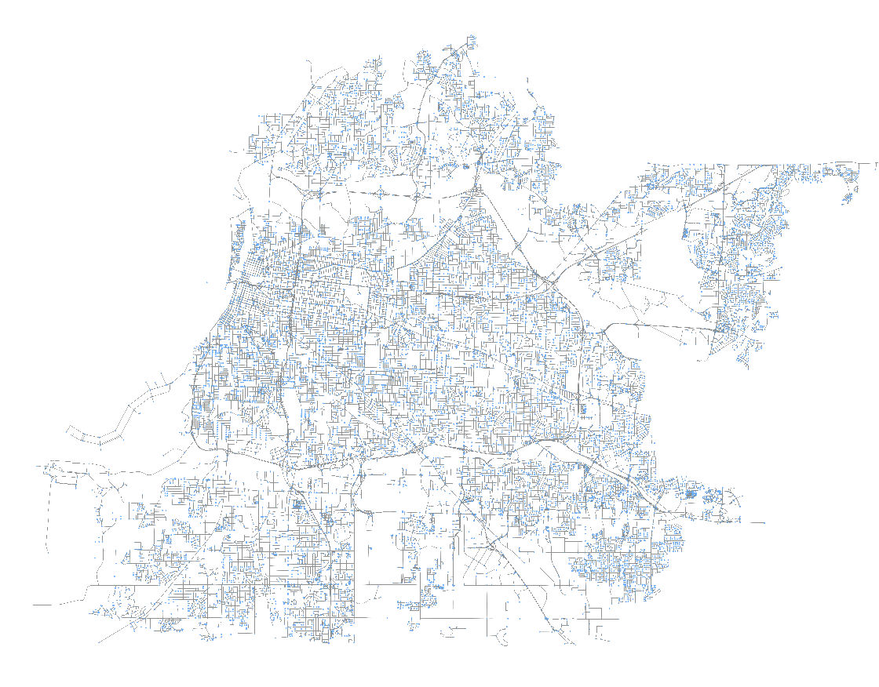
IE 532 – ANALYSIS OF NETWORK DATA
CASE 2: High Network Redundancy
Q: Where do we find these type of Bridge Transportation?
In most of the center of city transportation network
MEMPHIS,TN
603 / 64,398
Bridges Total Edges
UNIVERSITY OF ILLINOIS-URBANA CHAMPAIGN

Slide 28
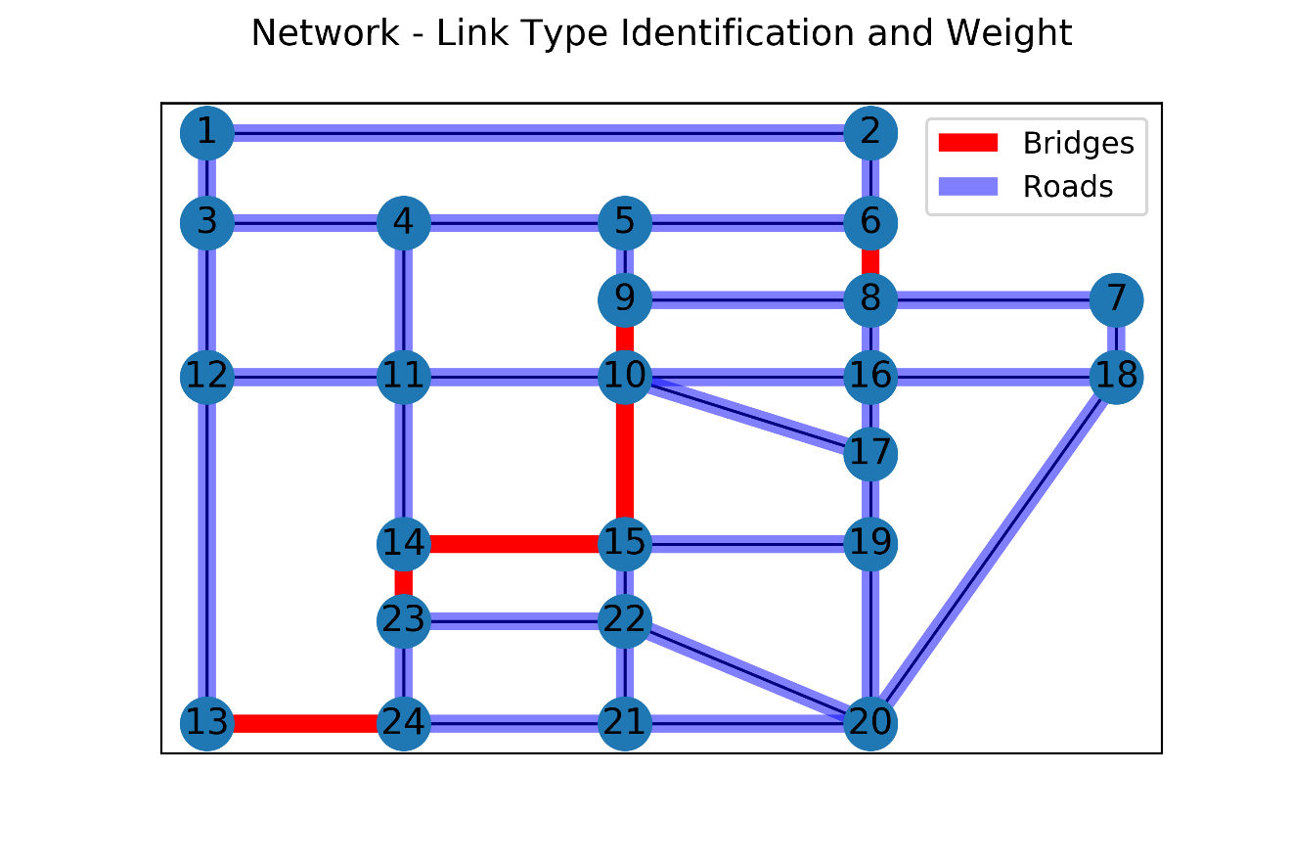
IE 532 – ANALYSIS OF NETWORK DATA
CASE 2: High Network Redundancy
STEP 1: Define Link Weight
STEP 2: Clustering Girvan-Newman
STEP 3: Adjust Bridge Dominance
STEP 4: Big Node and Super Link
Hypothetical Sioux Falls Network Liu, et.al. (2009)
UNIVERSITY OF ILLINOIS-URBANA CHAMPAIGN

Slide 29
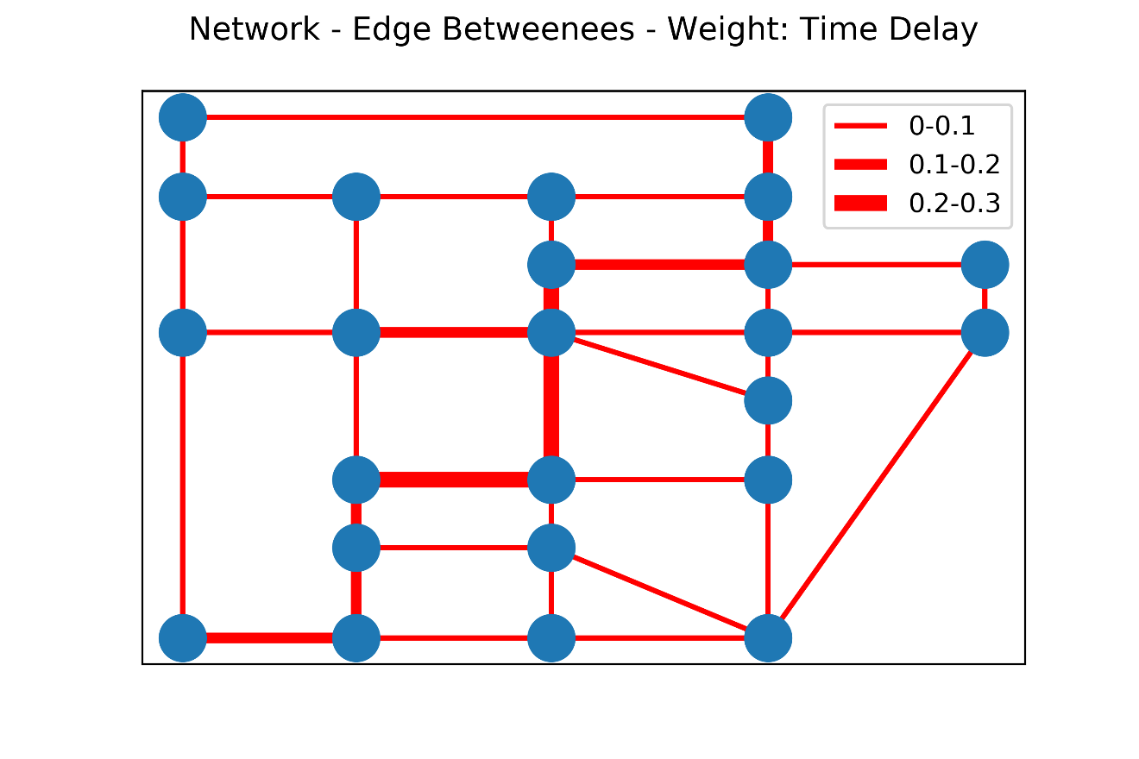
IE 532 – ANALYSIS OF NETWORK DATA
CASE 2: High Network Redundancy
STEP 1: Define Link Weight
STEP 2: Clustering Girvan-Newman
STEP 3: Adjust Bridge Dominance
STEP 4: Big Node and Super Link
Hypothetical Sioux Falls Network Liu, et.al. (2009)
UNIVERSITY OF ILLINOIS-URBANA CHAMPAIGN

Slide 30
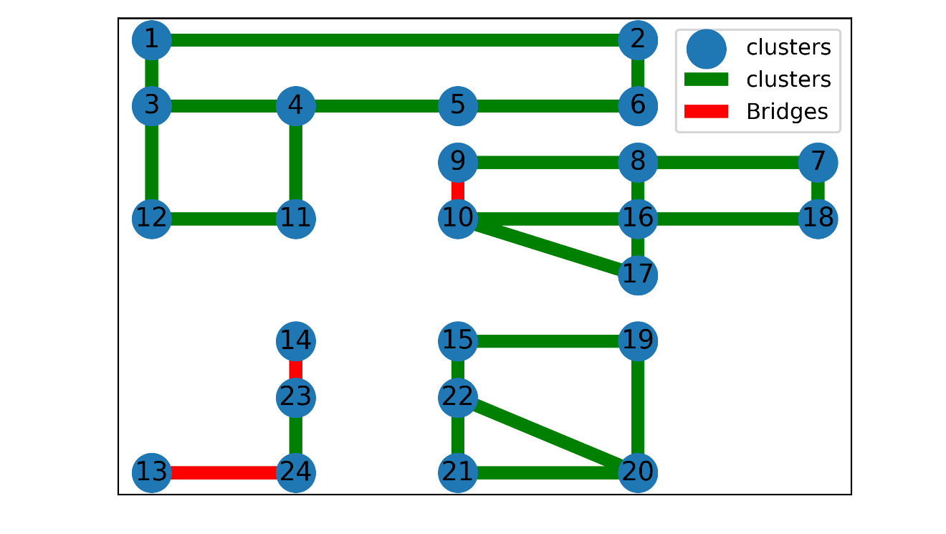
IE 532 – ANALYSIS OF NETWORK DATA
CASE 2: High Network Redundancy
STEP 1: Define Link Weight
STEP 2: Clustering Girvan-Newman
STEP 3: Adjust Bridge Dominance
STEP 4: Big Node and Super Link
Hypothetical Sioux Falls Network Liu, et.al. (2009)
UNIVERSITY OF ILLINOIS-URBANA CHAMPAIGN

Slide 31
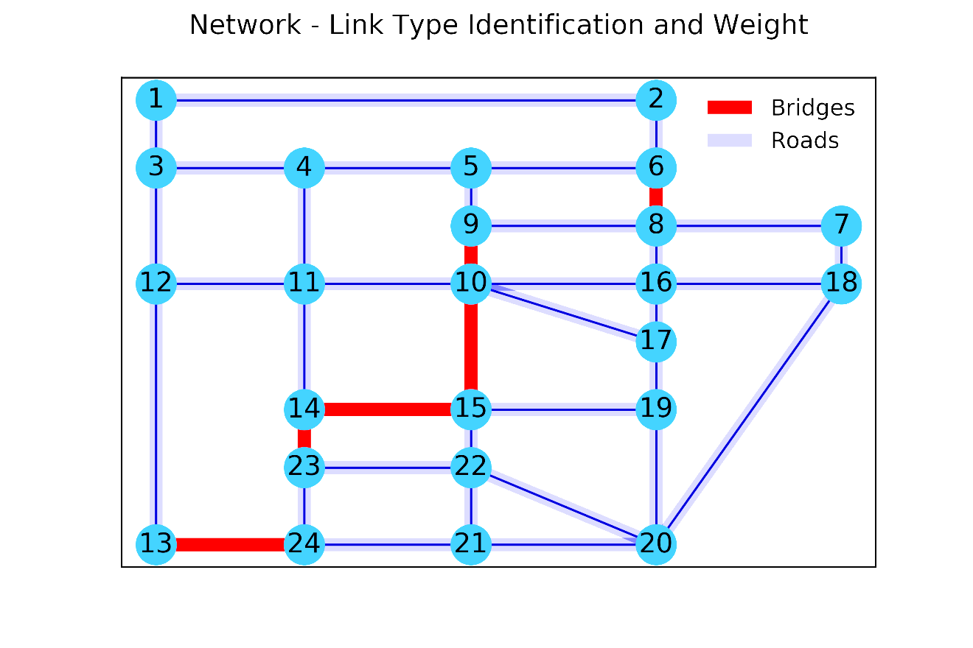
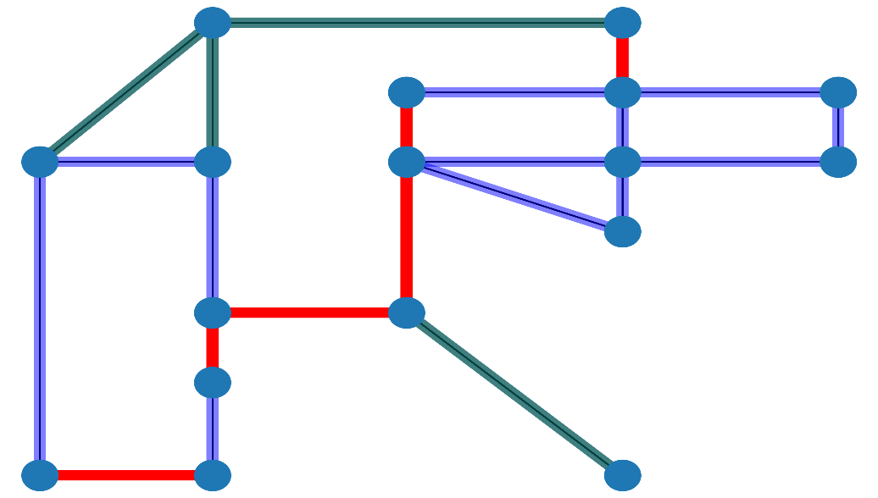
IE 532 – ANALYSIS OF NETWORK DATA
CASE 2: High Network Redundancy
UNIVERSITY OF ILLINOIS-URBANA CHAMPAIGN

Slide 32
IE 532 – ANALYSIS OF NETWORK DATA
CASE 3: Benefit of Clustering Reduction – Max Flow
UNIVERSITY OF ILLINOIS-URBANA CHAMPAIGN

Slide 33
IE 532 – ANALYSIS OF NETWORK DATA
CASE 3: Benefit of Clustering Reduction – Max Flow
S
S
T
T
Even though every bridges is failed, {s,t} is still connected due to network redundancy
Bridge plays as critical connection in the network.
UNIVERSITY OF ILLINOIS-URBANA CHAMPAIGN

Slide 34
IE 532 – ANALYSIS OF NETWORK DATA
CASE 3: Benefit of Clustering Reduction – Max Flow
S
S
T
T
Only one bridge becomes important in the network. There is still flow and connectivity from left-above network redundancy
Bridge plays as critical connection in the network.
UNIVERSITY OF ILLINOIS-URBANA CHAMPAIGN

Slide 35

Thank you!

